Slide 1
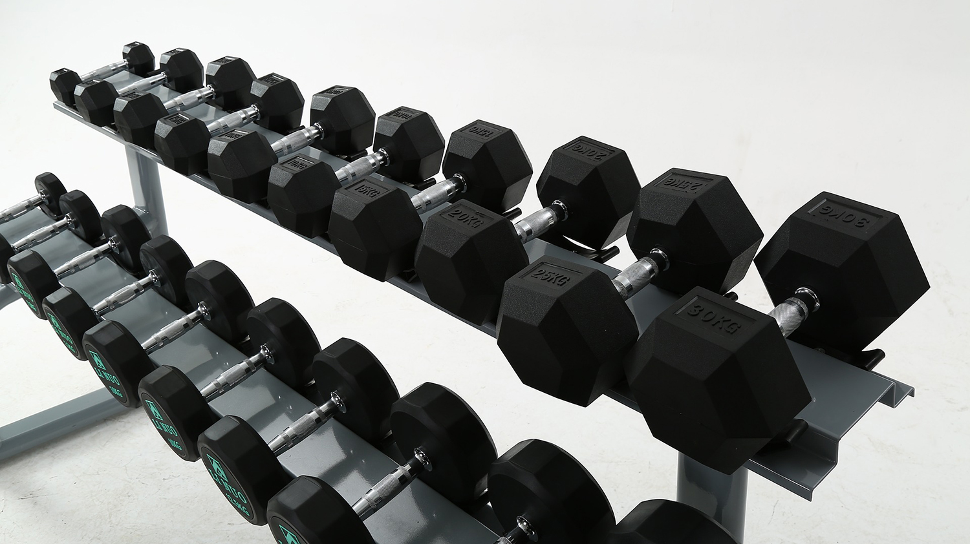
Bravo Builders

Slide 2

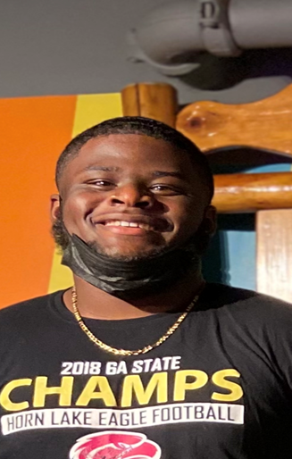
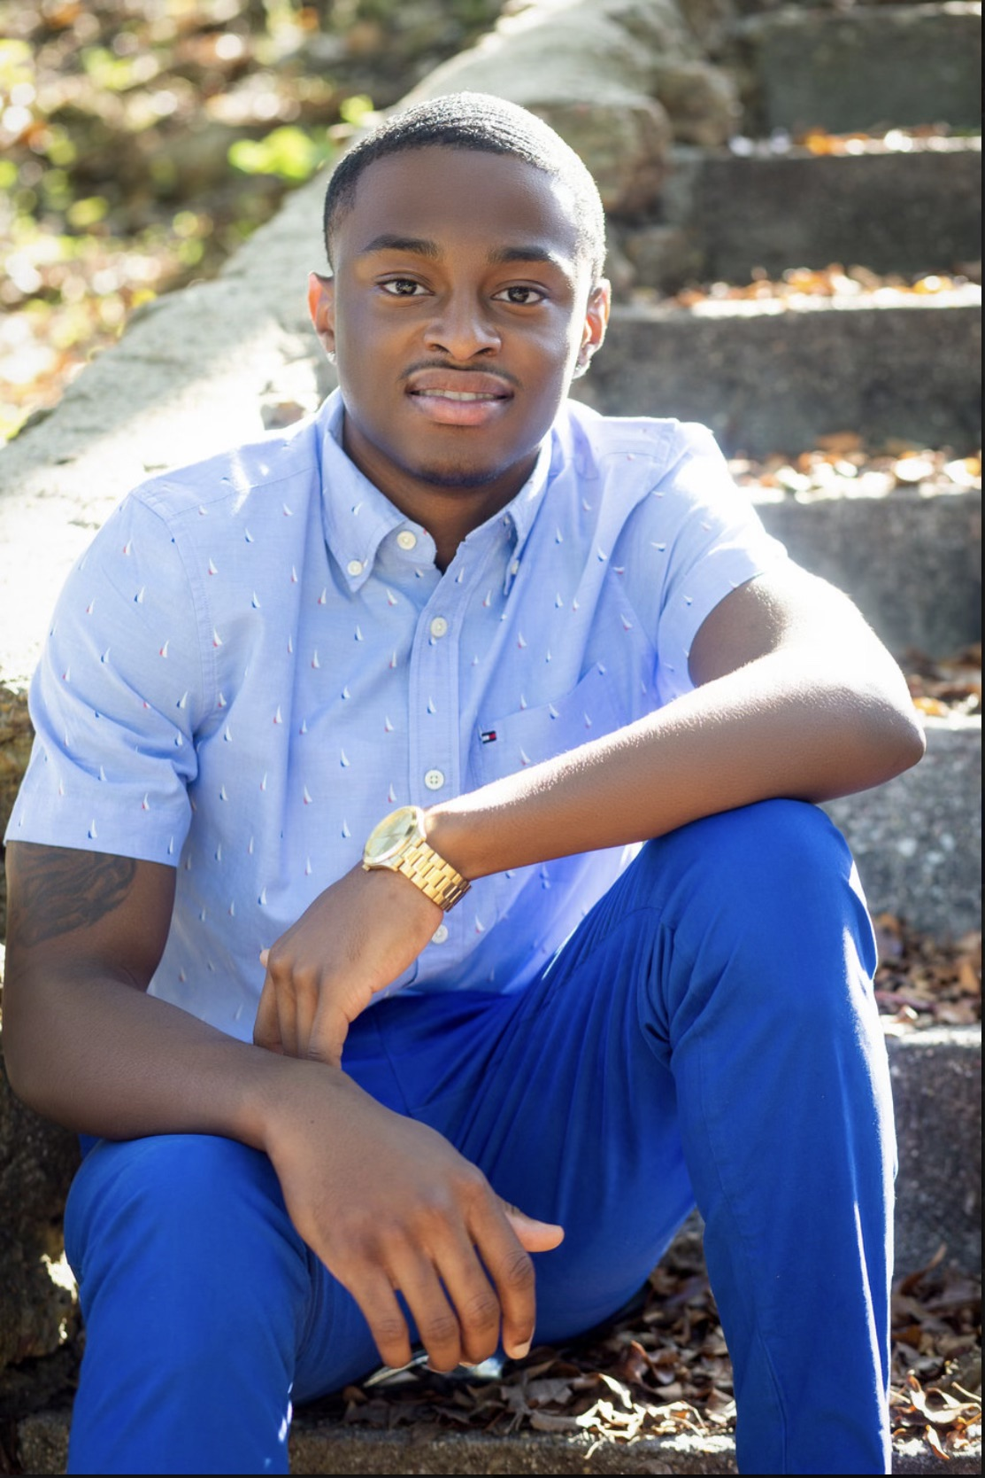
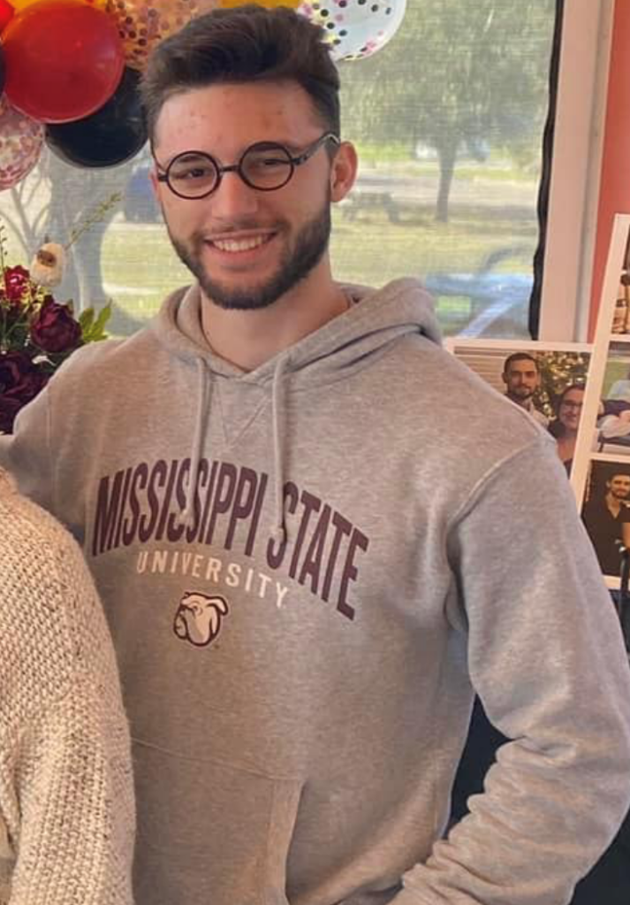
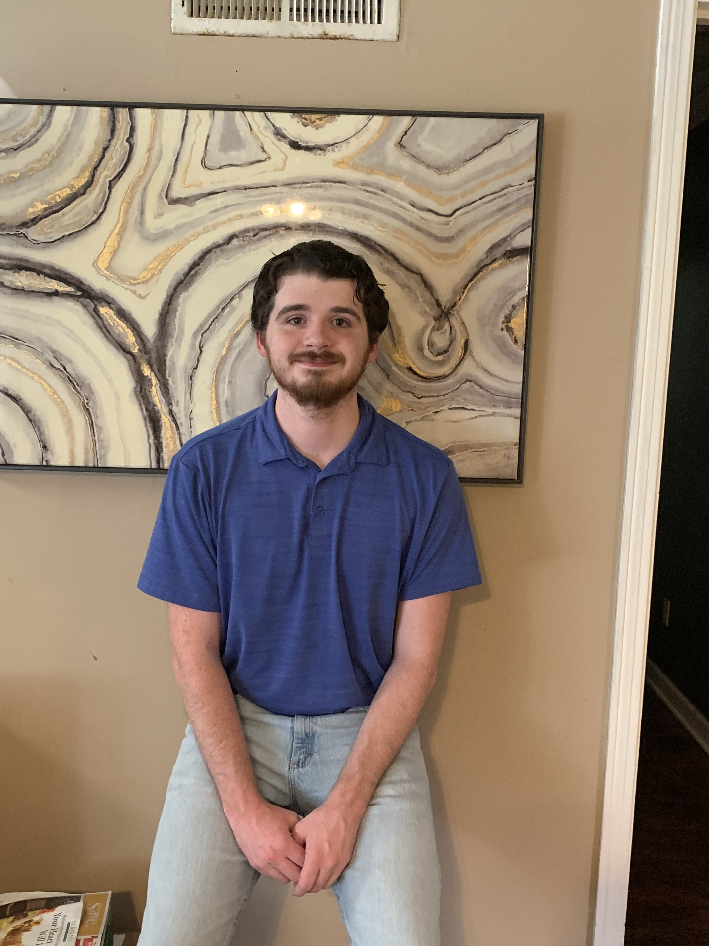
Meet the Team
Joseph Taylor
Team Lead & Fitting System Lead
Electrical Engineer
David Lock
Power System Lead
Electrical Engineer
Marlon Sims
Circuit Design Lead
Electrical Engineer
Austin Polk
Communications Lead
Electrical Engineer
Logan Dubuisson
App Development Lead
Computer Engineer

Slide 3

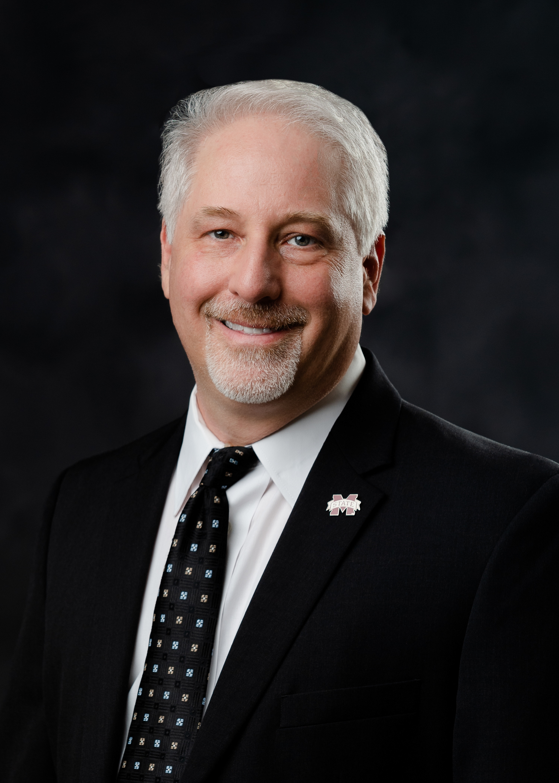
Advisors
Dr. Ali Gurbuz
Faculty Advisor
Dr. John Ball
Secondary Advisor
Senior Researcher, Athlete Engineering Research Lab

Slide 4

Bradley Johnson
54-year-old retired retail manager
Tight on money, can’t afford a personal trainer
Wants to get in shape to play with his two grandkids
Occasionally forgetful
Looking to start a workout routine, but inexperienced
Fig. 1. Adapted from [1]

Slide 5
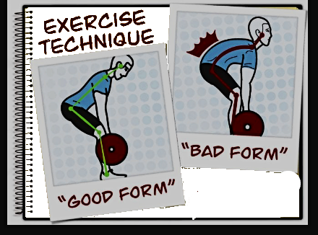
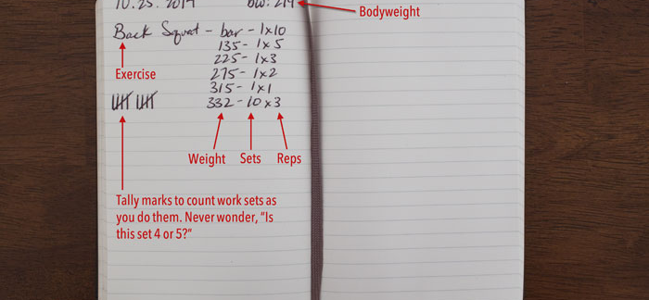
The Problem
Fig. 3. Adapted from [3]
Fig. 2. Adapted from [2]
Newcomer gym anxiety
Risk of injury (overloading weights, poor form)
Loss of repetition & set counting
Uncertainty in exercise choice
Lack of equipment

Slide 6
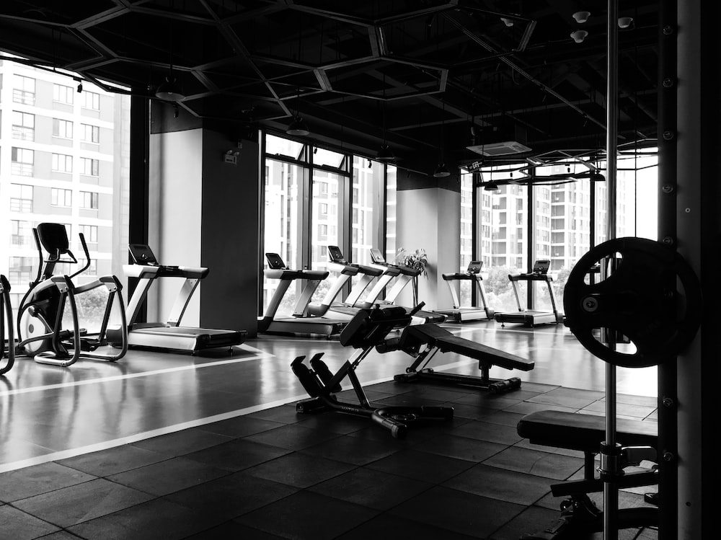

Target Audience
Gyms
Athletics
Fig. 4. Adapted from [4]
Fig. 5. Adapted from [5]

Slide 7
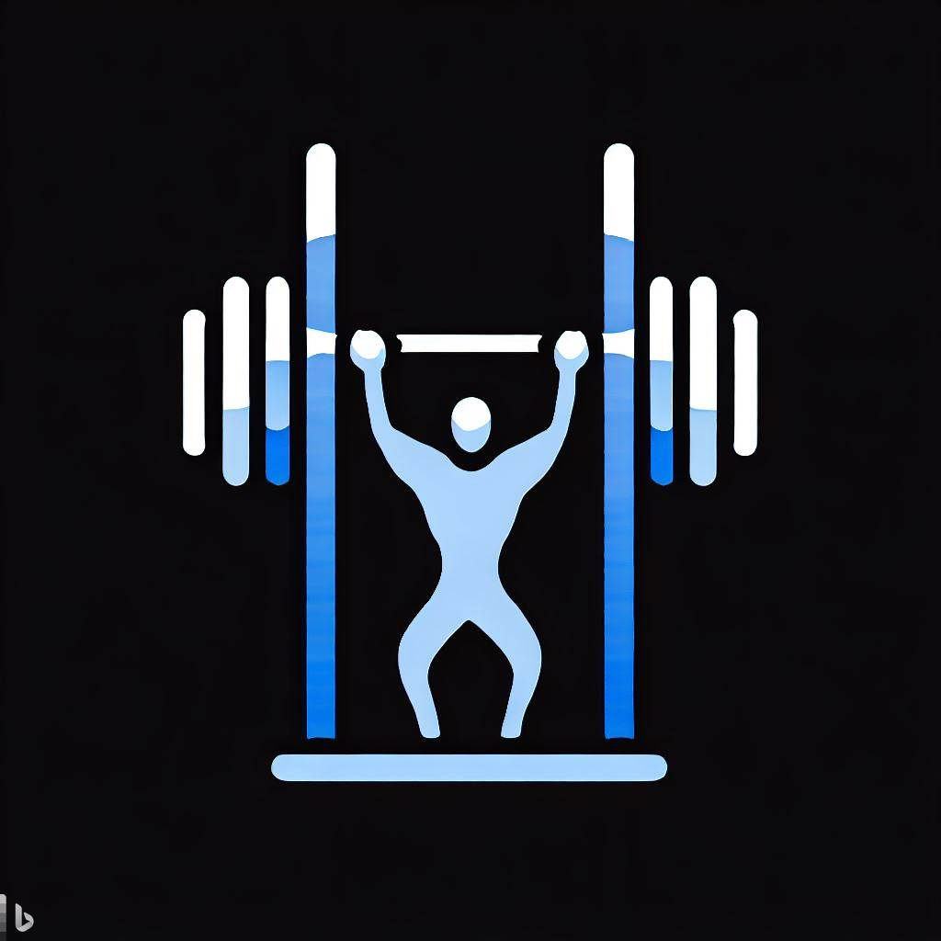
The Workout Buddy An integrated sensor & smart app solution for the Bradleys of the world
Free weight/machine position & motion tracker
Intuitive app integration for workout tracking & feedback
Fig. 6. Adapted from [6]

Slide 8
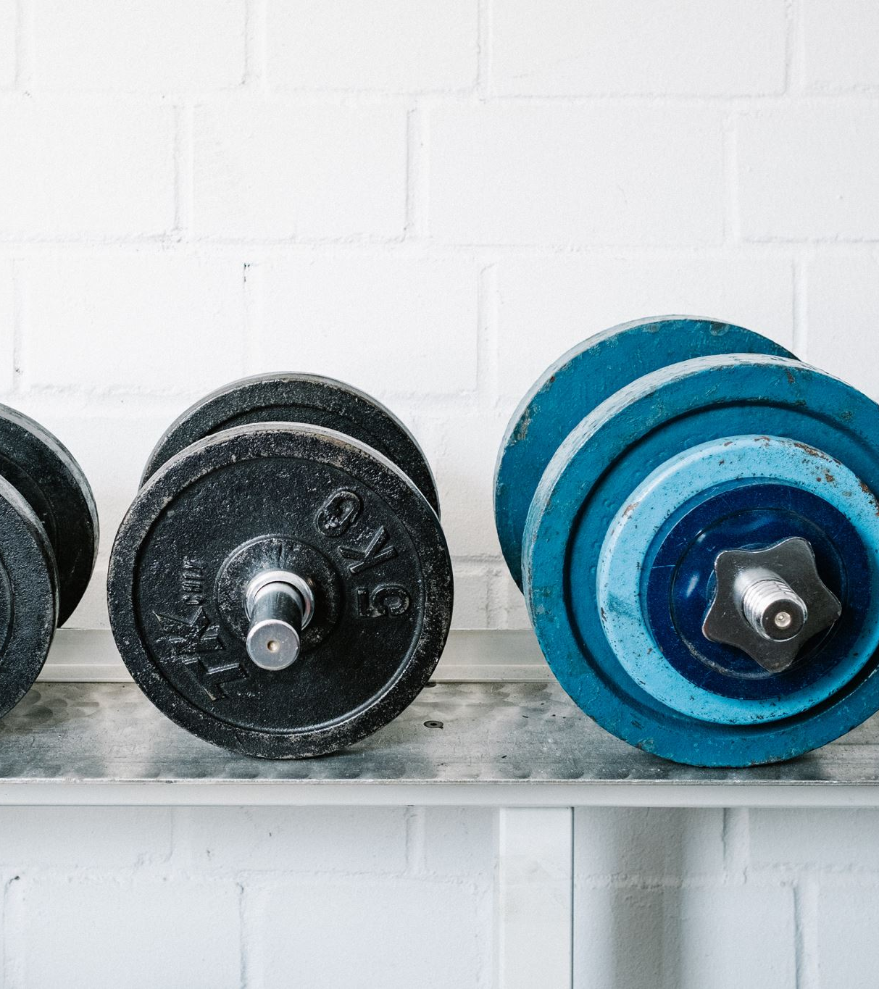
Competitive Advantage
Built-in tracking that would not only log workout reps & sets but also the qualitative attributes of the user’s workout
Workout form and technique feedback for improvement
Creation of workout routines to accomplish user-defined goals
Designed to work in tandem with existing fitness trackers for a more well-rounded workout experience

Slide 9
Citations
[1] Contrastaddict, “A studio portrait of a mature adult.,” iStock, https://www.istockphoto.com/photo/confused-adult-portrait-gm184134257-16768353 (accessed Sep. 5, 2023).
[2] M. S. N.M.P.T, “Good form vs bad form,” Graduate Fitness, https://graduatefitness.com/good-form-vs-bad-form/ (accessed Sep. 5, 2023).
[3] James Clear, “Hacking the workout journal: How to track your workouts in the simplest, most effective way possible,” James Clear, https://jamesclear.com/workout-journal (accessed Sep. 5, 2023).
[4] Unsplash, “100+ gym wallpapers [HQ]: Download free images on unsplash,” 100+ Gym Wallpapers [HQ] | Download Free Images On Unsplash, https://unsplash.com/s/photos/gym (accessed Sep. 5, 2023).
[5] “Athletics information // <![CDATA[ _spbodyonloadfunctionnames.push(‘setuppagedescriptioncallout’); // ]]>,” Godley Station School Athletics Information, https://www.sccpss.com/schools/gss/Pages/Athletics-Information.aspx (accessed Sep. 5, 2023).
[6] Bing, https://www.bing.com/images/create/squat-rack-app-logo/64ef66edea6440af96191250856a6271?id=PoeiWpBuL0JQNOmpc4Ov3g%3D%3D&view=detailv2&idpp=genimg&form=GCRIDP&ajaxhist=0&ajaxserp=0 (accessed Sep. 5, 2023).

